Slide 1
Using Bayesian Optimization in Pose Graphs Based SLAM 24th July
Zuxun Wang

Slide 2
Progress Since Last Meeting
Modify code structure and rename some files for better readability
Modify plotting and surface plot functions
chi2Plotting can generate plots and save plots and matrices to specified location
Surf plots can read all .csv files starting with “C_” to generate surface plots for CNESS values of different systems
Change codes to generate subgraphs for linear system
Use Baye Opt for learning R and Q

Slide 3
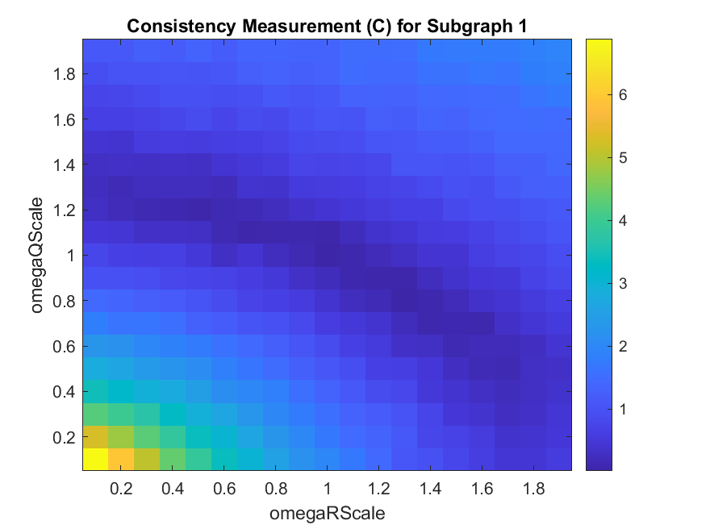
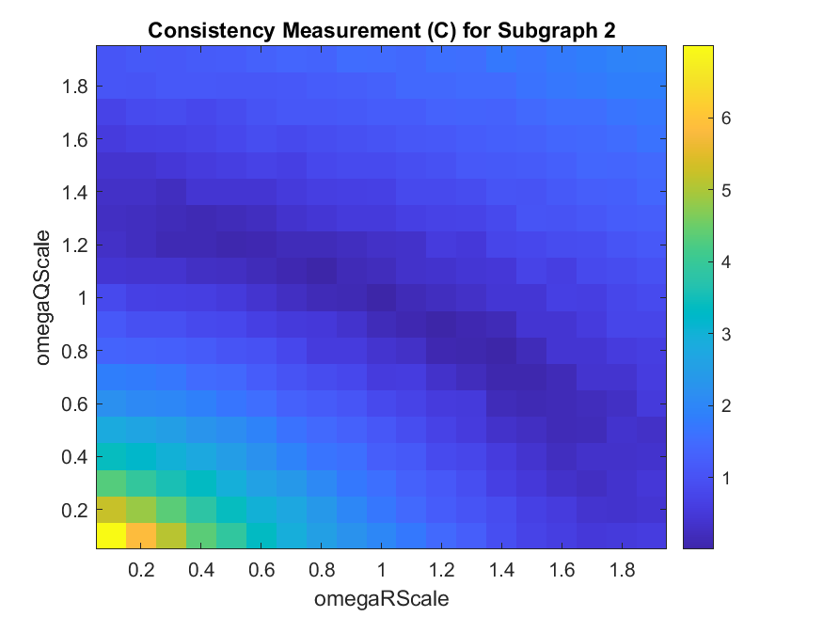
Consistency Measurement Metric for Linear System with Two Subgraphs (Proposition 3)

Slide 4
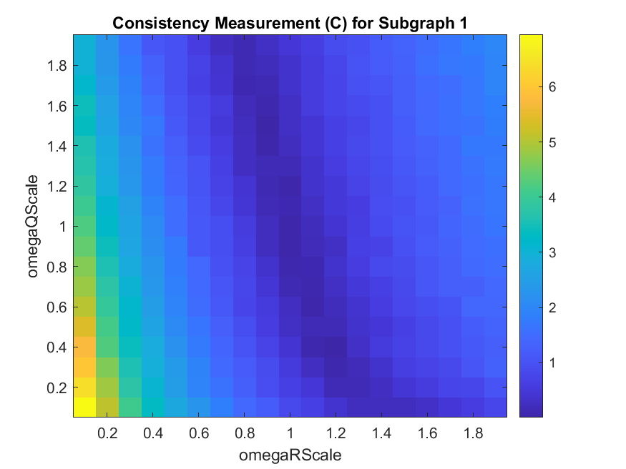
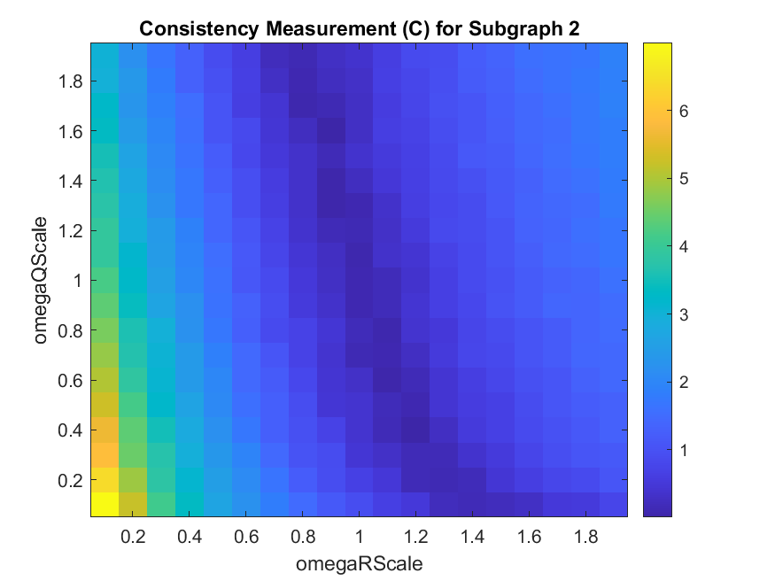
Consistency Measurement Metric for Linear System with Two Subgraphs (Enable Proposition 4)

Slide 5
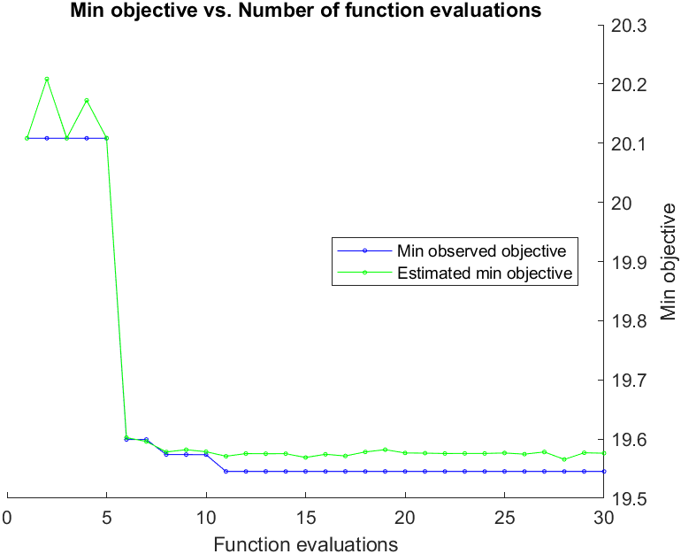
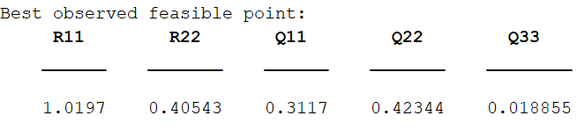
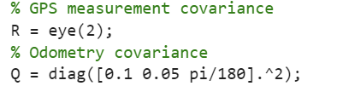
Bayesian Optimisation – GPS (Disable Proposition 4)
Total number of timestep: 40
Number of episodes: 10000
numObs: /
obsPeriod: /
AcqFunc: ExpectedImprovementPlus

Slide 6
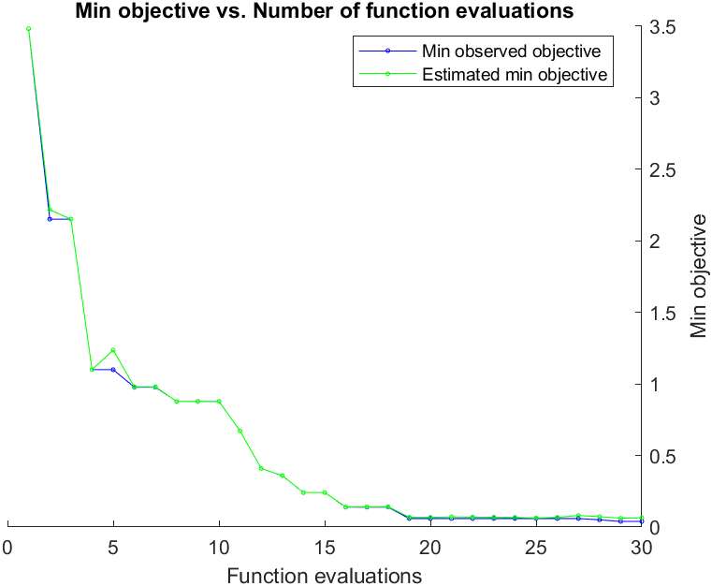
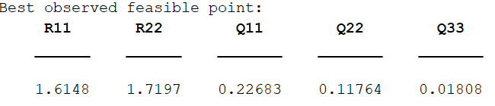
Bayesian Optimisation – GPS (Enable Proposition 4)
Total number of timestep: 40
Number of episodes: 10000
numObs: /
obsPeriod: /
AcqFunc: ExpectedImprovementPlus

Slide 7
Problems / Issues

Slide 8
Planned Activities

